Slide 1
Scenario 1
Shaun sits a Mathematics test and achieves a mark of 27.
In the next test, he scores 30. Has he improved?
Do we know what each test was out of?
Test 1 was out of 40 and test 2 was out of 50. Do we now know if he improved?
Were the tests of similar difficulty? What was the mean mark in each test?
The mean in test 1 was 23 and the mean in test 2 was 25.
Now can we say he improved?
What if we knew the standard deviation as well?
The standard deviation in test 1 was 5 marks and in test 2 it was 10 marks.
Now can we suggest whether Shaun’s marks have improved?

Slide 2



Scenario 1
To help us with the problem seen in the last slide, we can express Shaun’s test scores as the number of standard deviations away from the mean.
Doing this is called standardising the score. We obtain the standard score (known as a z score).
$$Standardised score=\frac{raw score − mean}{standard deviation}$$
Test 1: Shaun’s score: 27 Mean: 23 Standard deviation: 5
Test 2: Shaun’s score: 30 Mean: 25 Standard deviation: 10
$$Standardised score 1: = \frac{27 −23}{5}=\frac{4}{5}=0.8$$
This suggests that compared to other students in his class, Shaun performed better in test 1 than test 2.
$$Standardised score 2: = \frac{30 −25}{10}=\frac{5}{10}=0.5$$

Slide 3
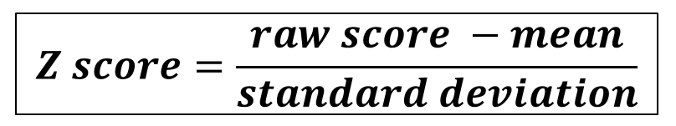
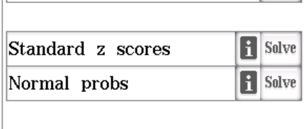
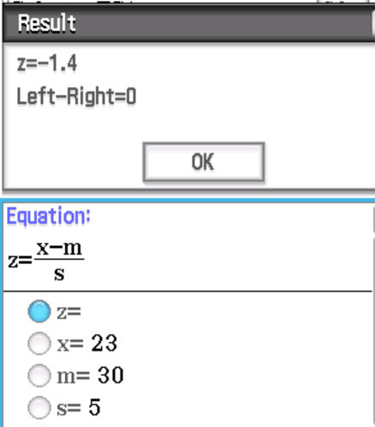



Example 1
Now do exercise 13A
Jennifer scores 23, 35 and 17 in tests A, B and C respectively.
Express each of Jennifer’s test scores as standardised scores (z scores).
Test A: Jennifer’s score: 23 Mean: 30 Standard deviation: 5
Test B: Jennifer’s score: 35 Mean: 32 Standard deviation: 6
Test C: Jennifer’s score: 17 Mean: 15 Standard deviation: 2.5
$$Standardised score A: = \frac{23 −30}{5}=\frac{−7}{5}=−1.4$$
$$Standardised score B: = \frac{35 −32}{6}=\frac{3}{6}=0.5$$
We can use the formula or use the e-activity on our Class Pads to get these standardised scores.
$$Standardised score C: = \frac{17 −15}{2.5}=\frac{2}{2.5}=0.8$$

